Slide 1


Advanced Topic Presentation
IST719 - Information Visualization
Sathish Rajendiran

Slide 2
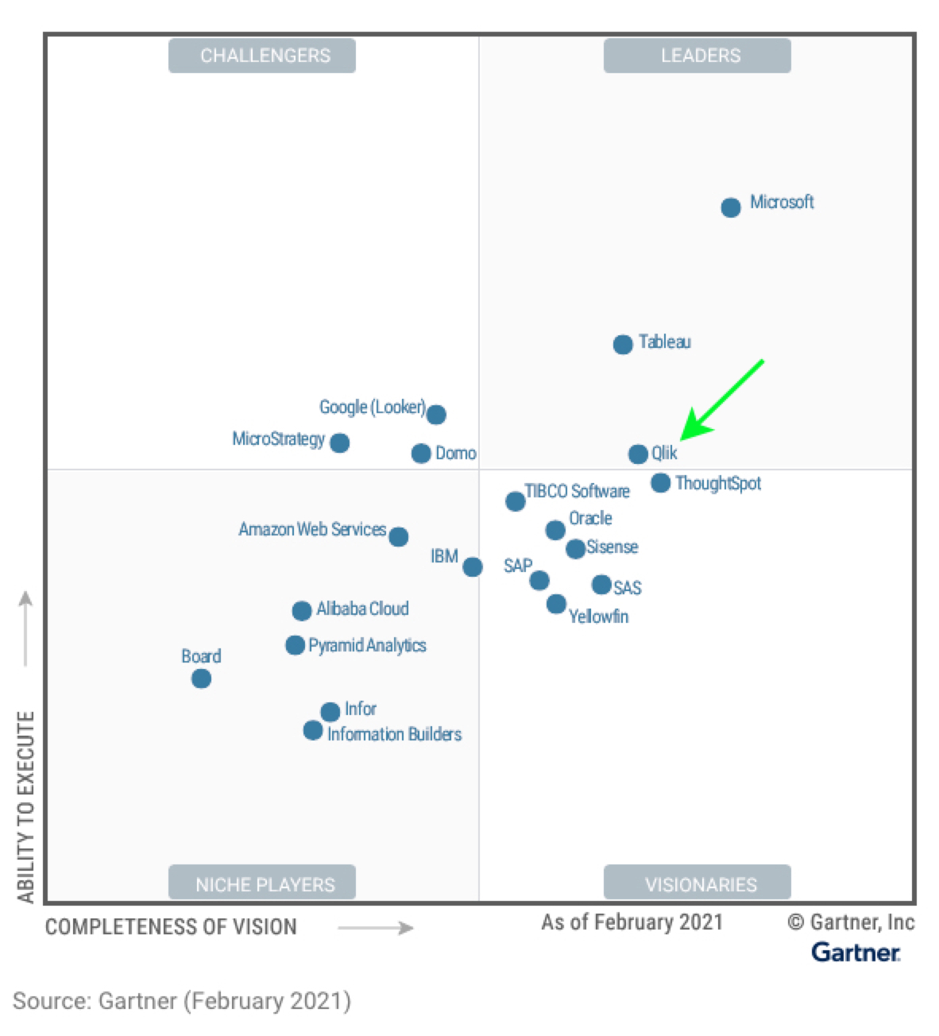


Why Qlik?
Accelerate business value with data – on our cloud or any cloud.
Turn raw data into remarkable outcomes with end-to-end, multi-cloud data integration and analytics solutions.
Close the gaps between data, insights, and action.
Magic Quadrant for Analytics and Business Intelligence Platforms

Slide 3
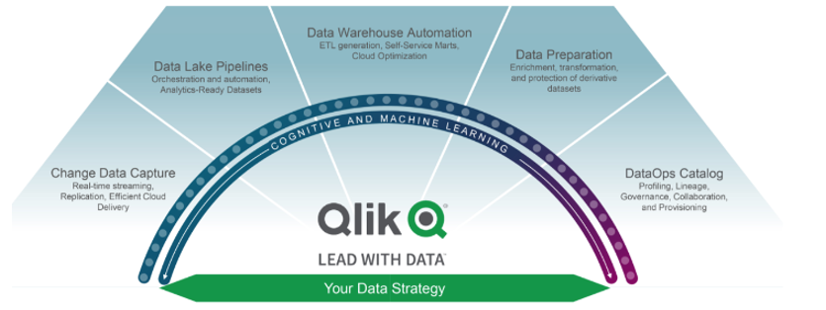

Functionalities - Data Integration Platform

Slide 4
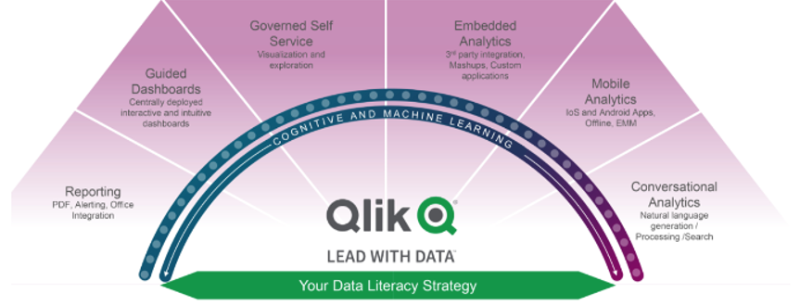
Functionalities - Insight Delivery & Literacy

Slide 5
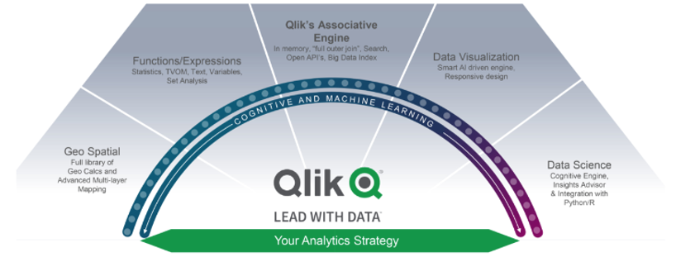
Functionalities - Advanced Analytics

Slide 6
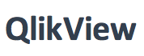
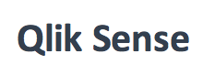
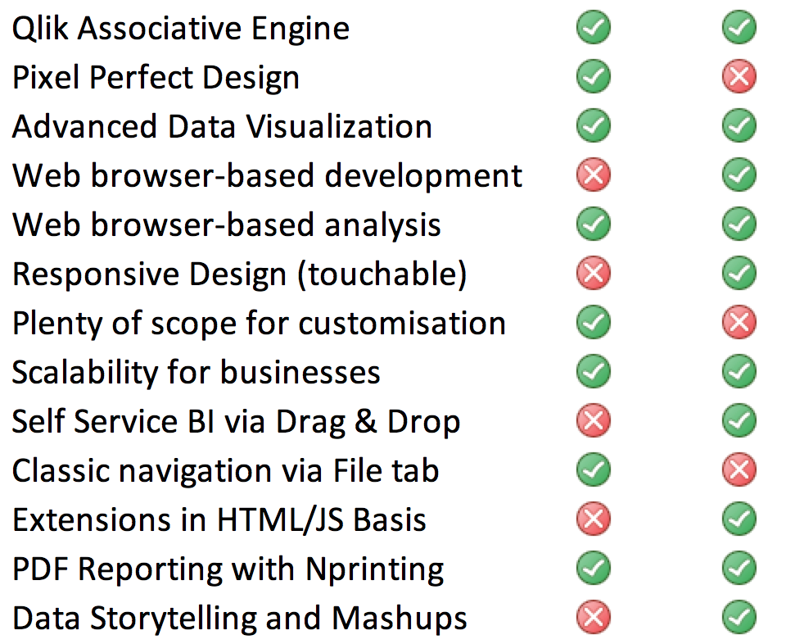
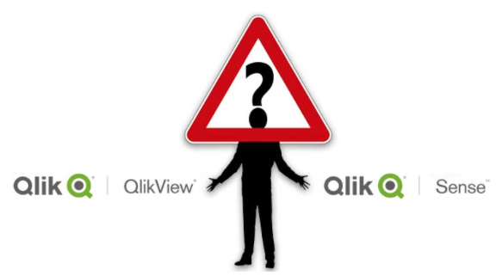
Product Comparison

Slide 7
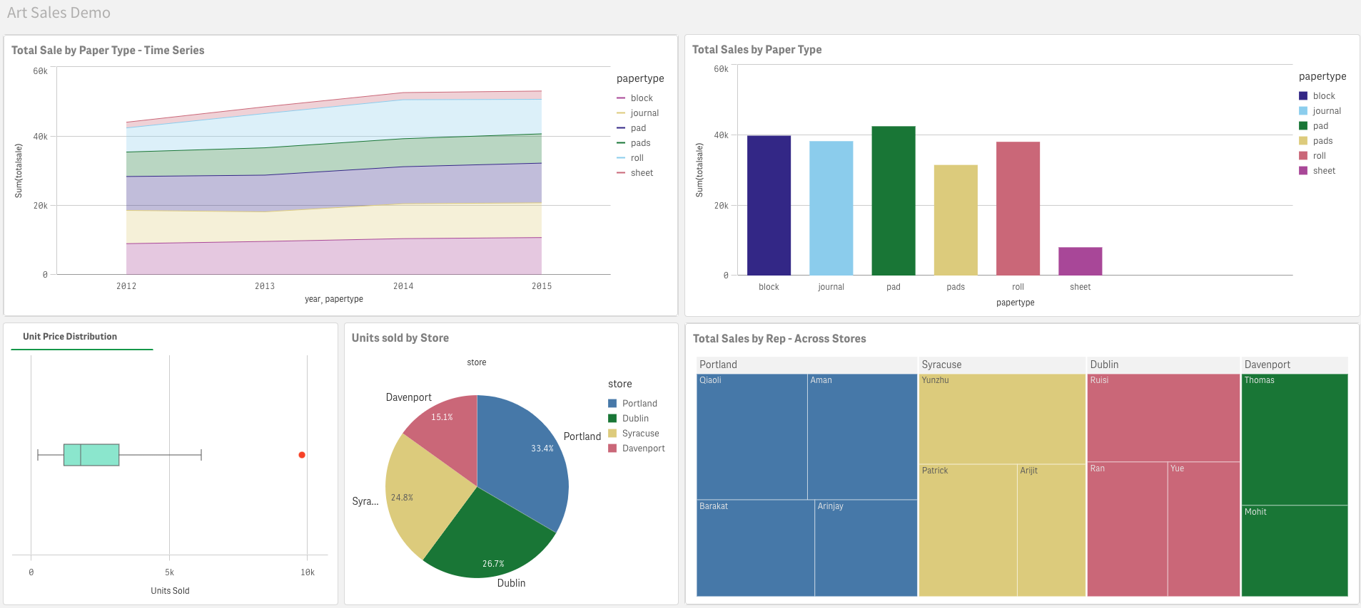
Data Visualization

Slide 8
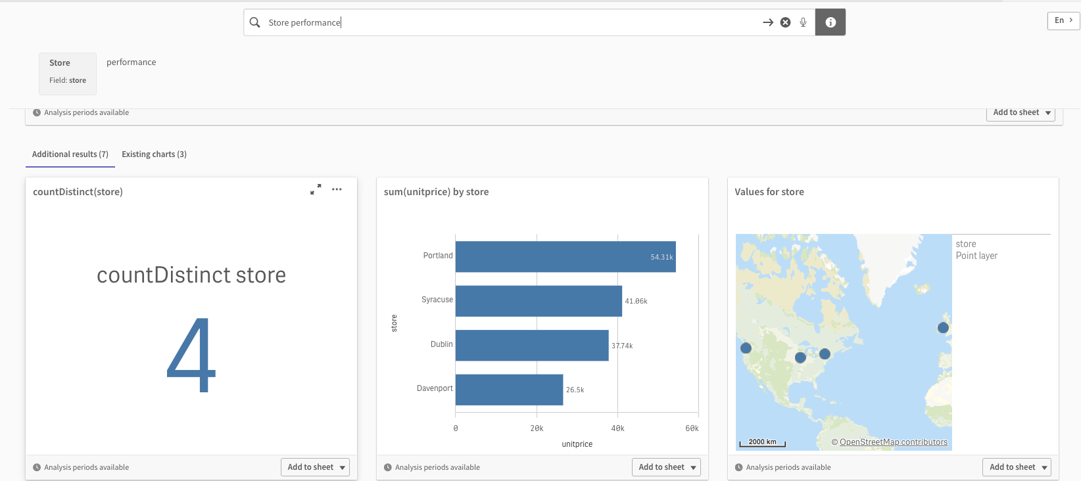
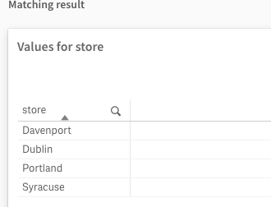
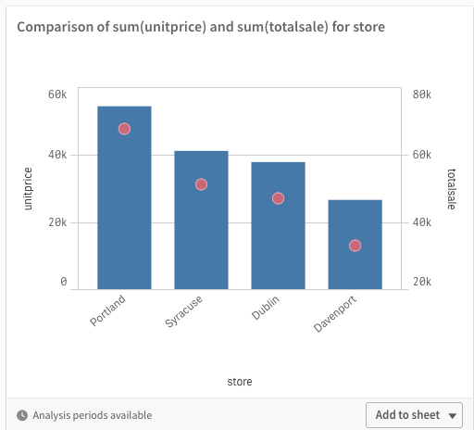
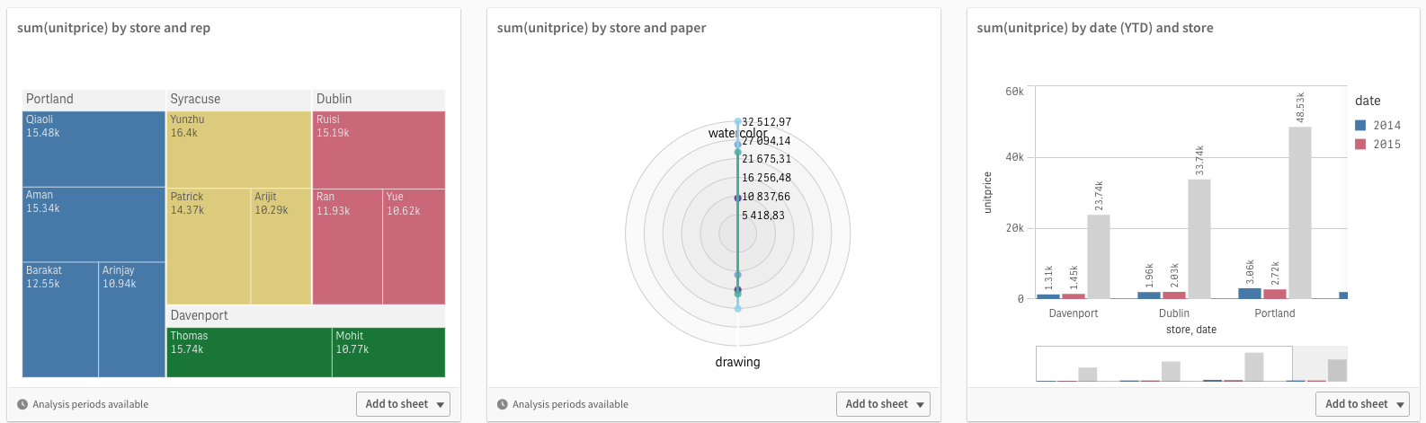
Value Analytics - AI (NLP) driven Insights

Slide 9
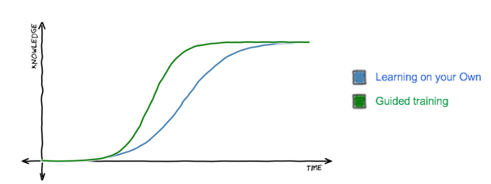
Learning Curve & References
https://help.qlik.com/en-US/cloud-services/Subsystems/Hub/Content/Sense_Hub/Introduction/get-set-up.htm
https://learning.qlik.com/ - Convenient, Self-paced with Free courses and Interactive webinars
https://www.clearpeaks.com/qlik-sense-custom-themes/ - Custom themes
https://www.qlik.com/blog/posts/trends/big-data-analytics/

Slide 10


Slide 11
Sathish Rajendiran

